Slide 1
Oxy Long Beach, Inc. Drilling Program Overview
Occidental Petroleum Corporation ■ ISCWSA ■ Long Beach ■ 5/9/2014 ■ Julien Roubaud / Jason Mena
Notes:
To add square symbols, choose Insert | Symbol and look for the Black Square in the Geometric Shapes subset. Or you can copy and paste this symbol. ■

Slide 2
Agenda
Introductions
History
Island layouts
Well design
Anti-collision challenges

Slide 3
Bio – Julien Roubaud
Drilling Engineer – Oxy Long Beach, Inc. (OLBI)
Experience
8 years in the industry
6 years with Schlumberger Wireline
Vernal UT – Reservoir Evaluation
Bakersfield CA – Reservoir Evaluation
Long Beach CA – Reservoir Evaluation and Completion / Production
2 years with Oxy
Drilling Engineer for onshore rigs and offshore platform

Slide 4
Bio – Jason Mena
Senior Drilling Engineer – Oxy Long Beach, Inc. (OLBI)
Experience
10 years in the industry
Schlumberger REW as an Open Hole Logging Engineer.
2004 Bakersfield, CA (FE REW)
2005 Villahermosa, Mexico (FE D&M)
2006 Egypt (FE REW)
2007-2009 Saudi Arabia (FE Offshore Operations)
2009-2010 GOM (SFE DW Offshore Operations)
4 years with Oxy
THUMS / Tidelands / Huntington Beach

Slide 5
Oxy Operating Sites
LA BASIN OIL FIELDS
California
San Vicente
Salt Lake
Los Angeles
Beverly Hills
Sawtelle
Las Cienegas
Montebello
L.A. Basin
Cheviot Hills
Inglewood
Whittier
Potrero
Bandini
Sansinena
Playa Del Rey
Brea Olinda
El Segundo
Rosecrans
Santa Fe Springs
Coyote
Yorba Linda
Pacific Ocean
Dominguez
Kraemer
Long Beach
Richfield
Torrance
Tidelands
Seal Beach
N
Belmont Offshore
Wilmington Oil Field
Newport
Long Beach Unit
0
4
8
12
Huntington Beach
Scale in Miles

Slide 6
North America’s Giant Oil Fields
Total Recovery (Bbbls)
Prudhoe Bay
East Texas
Wilmington*
Midway Sunset
Kuparuk
* Reached 1 billion bbls recovered in the Long Beach Unit July 2011

Slide 7
History
Wilmington field discovered 1932
Rapid development of onshore portion 1930’s - 1950’s
“Subsidence Bowl” develops onshore 1940’s
29 feet
5.5 miles long
by 0.75 miles wide
Max subsidence rate
28 inches per year
Long Beach residents vote to prohibit 1956 offshore development

Slide 8
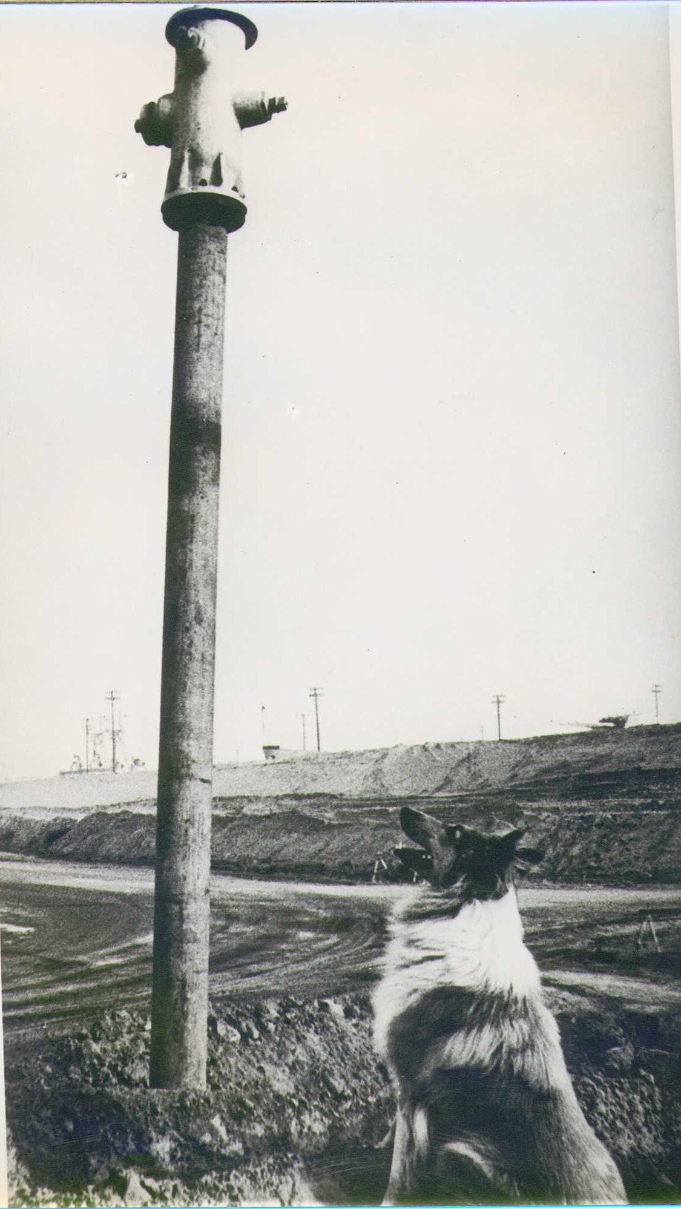
History
Waterflooding proved to control
subsidence in the Late 50’s
Residents approve offshore leasing
under strict controls in 1962
THUMS begins field development
in 1965

Slide 9
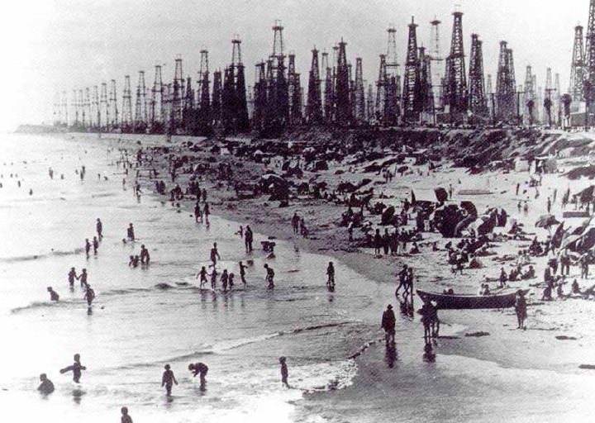
History
Huntington Beach in the 1930’s
Surf City USA

Slide 10

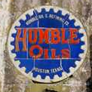



What does THUMS stand for?

Slide 11
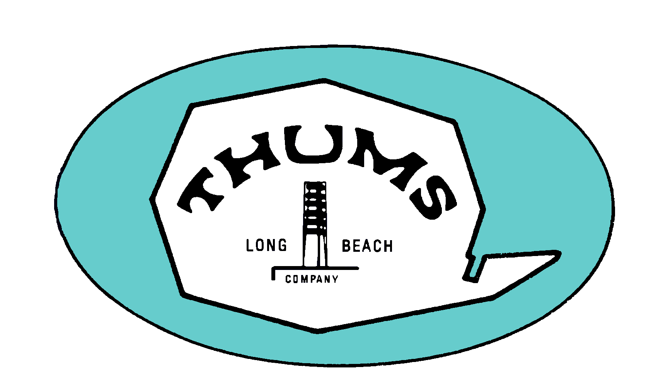



A Partnership
OLBI is City’s contractor
Thums Long Beach Company is agent for OLBI
Day to day operations
Direction by City
Unit Operator - Long Beach Unit and other Wilmington Units
Trustee for State for offshore area
Major financial stakeholder

Slide 12
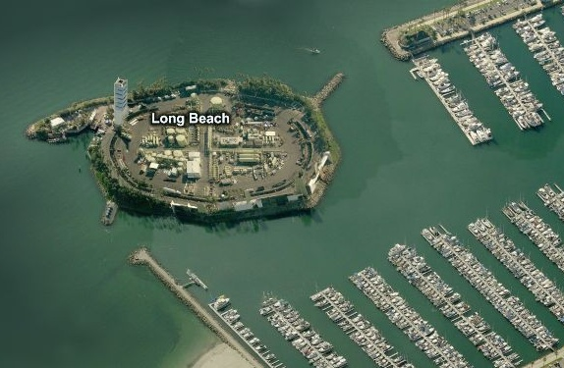
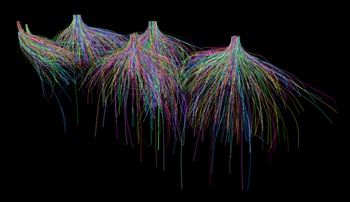
Oxy: A global Leader in Close-Proximity Well Placement Challenges
Directional Drilling
Experience and Technology
Reduce Environmental Impact
Minimize Footprint
Increase Efficiency
Lower Drilling Costs
Onshore Multi-Well Pads & Island Locations
Notes:
Discuss the value in using directional drilling practices

Slide 13
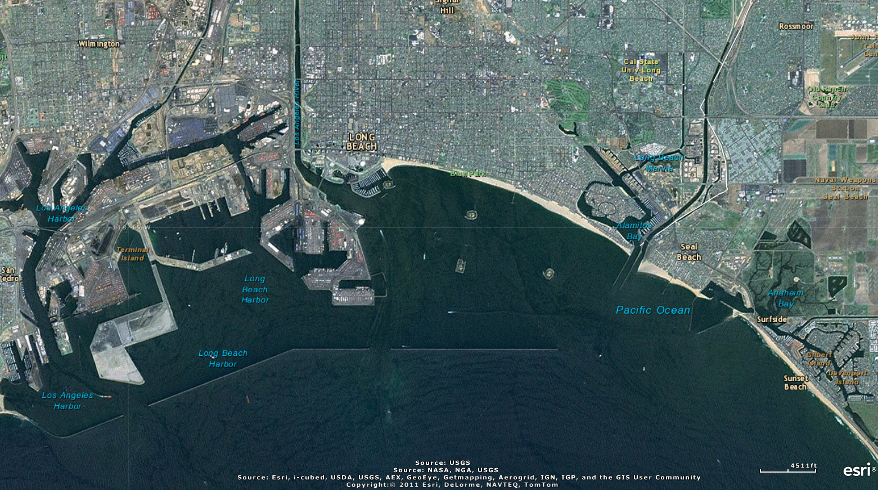
Long Beach, CA

Slide 14
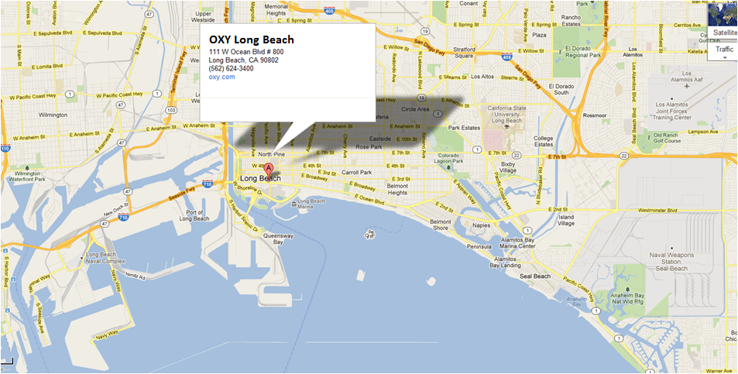
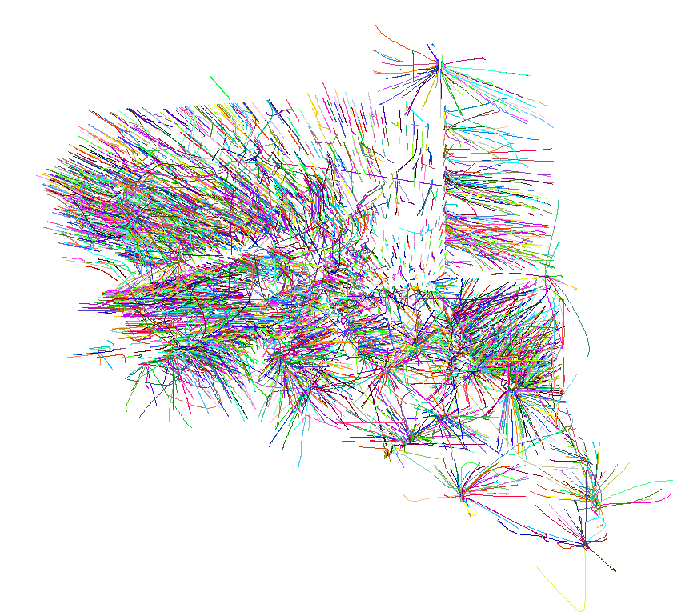
Oxy Long Beach Office

Slide 15
Wilmington Field (West to East View)

Slide 16
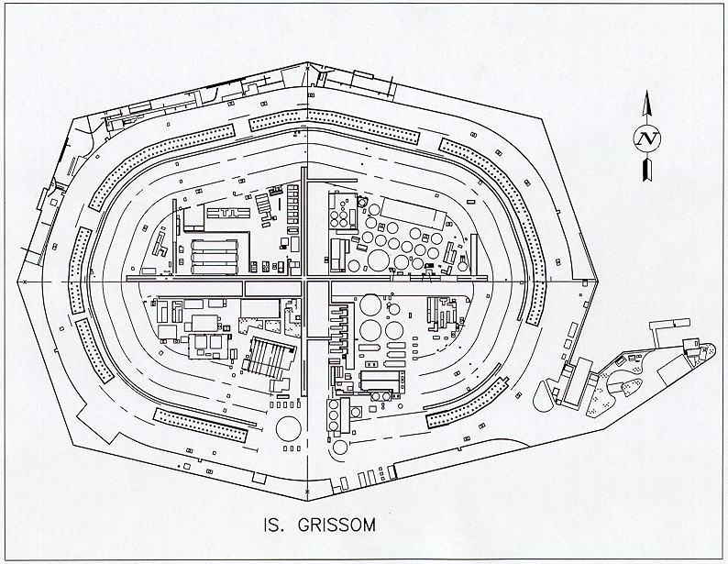
Island Grissom Schematic

Slide 17
THUMS General Wellhead / Slot Layout
Island Wellhead Spacing
6’ center to center
12’ between the double rows
Chaffee & Freeman have an additional cellar 50’ behind the 1st cellar

Slide 18
Oxy Long Beach Inc. - Drilling/Well Servicing Rigs
The LBU owns 3 drilling rigs and Oxy owns 1 drilling rig in Huntington Beach (Offshore Platform Emmy)
Labor contracts in place for each of 4 rigs
4 contract drilling rigs supporting LBU, Tidelands and Huntington Beach programs
11 contract production rigs at the LBU and Tidelands
5 contract production rigs at Huntington Beach and other sites

Slide 19
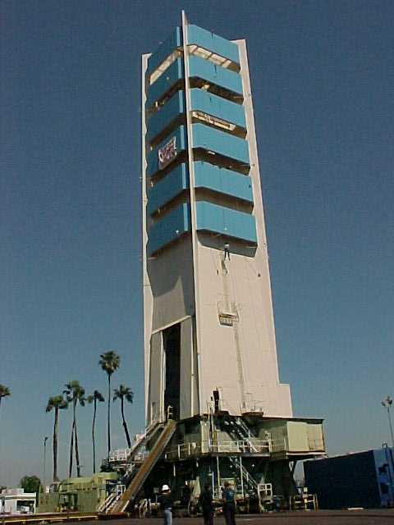
Island Drilling Rigs
T5 on Grissom
T9 on Chaffee
T3 on White

Slide 20
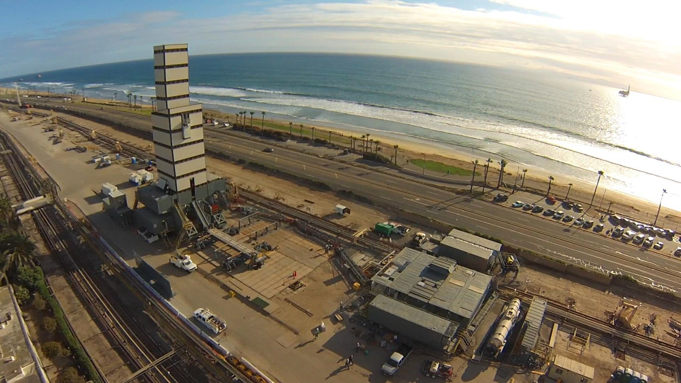
Huntington Beach – Enclosed Drilling Rig

Slide 21
Deviated Well Design

Slide 22
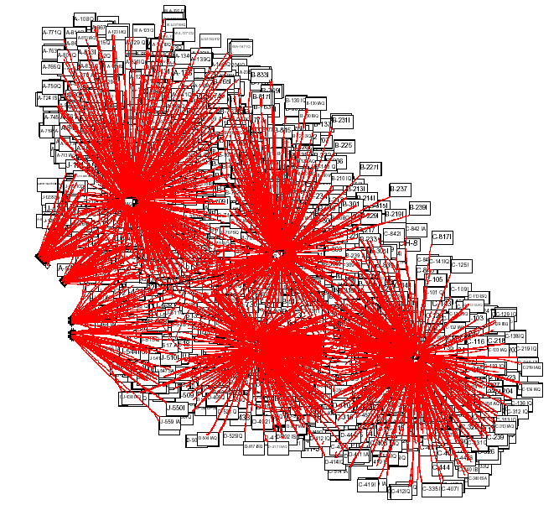
Radial Drilling Pattern
White
Grissom
Chaffee
Pier
Belmont
Freeman

Slide 23
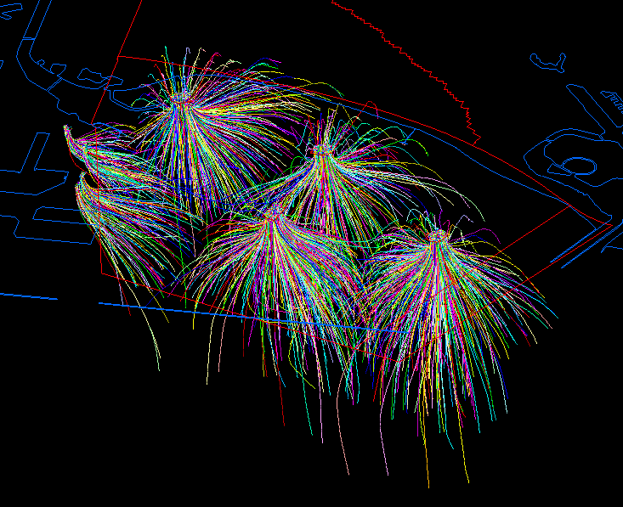
THUMS

Slide 24
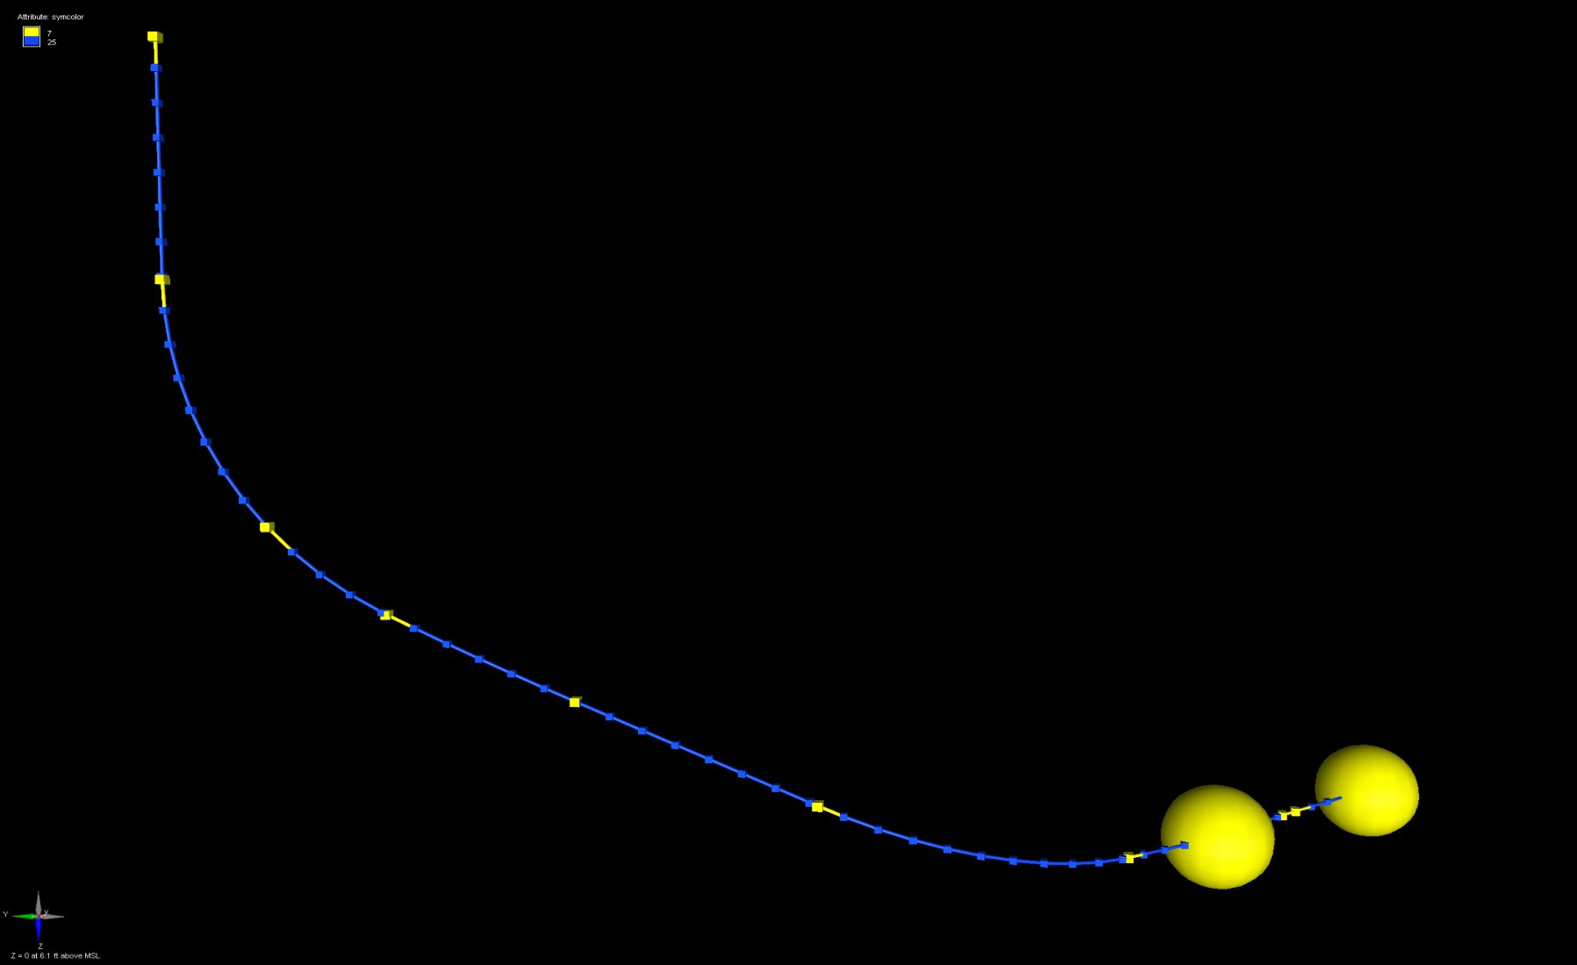
Example 3D Horizontal Path (Actual Well)

Slide 25
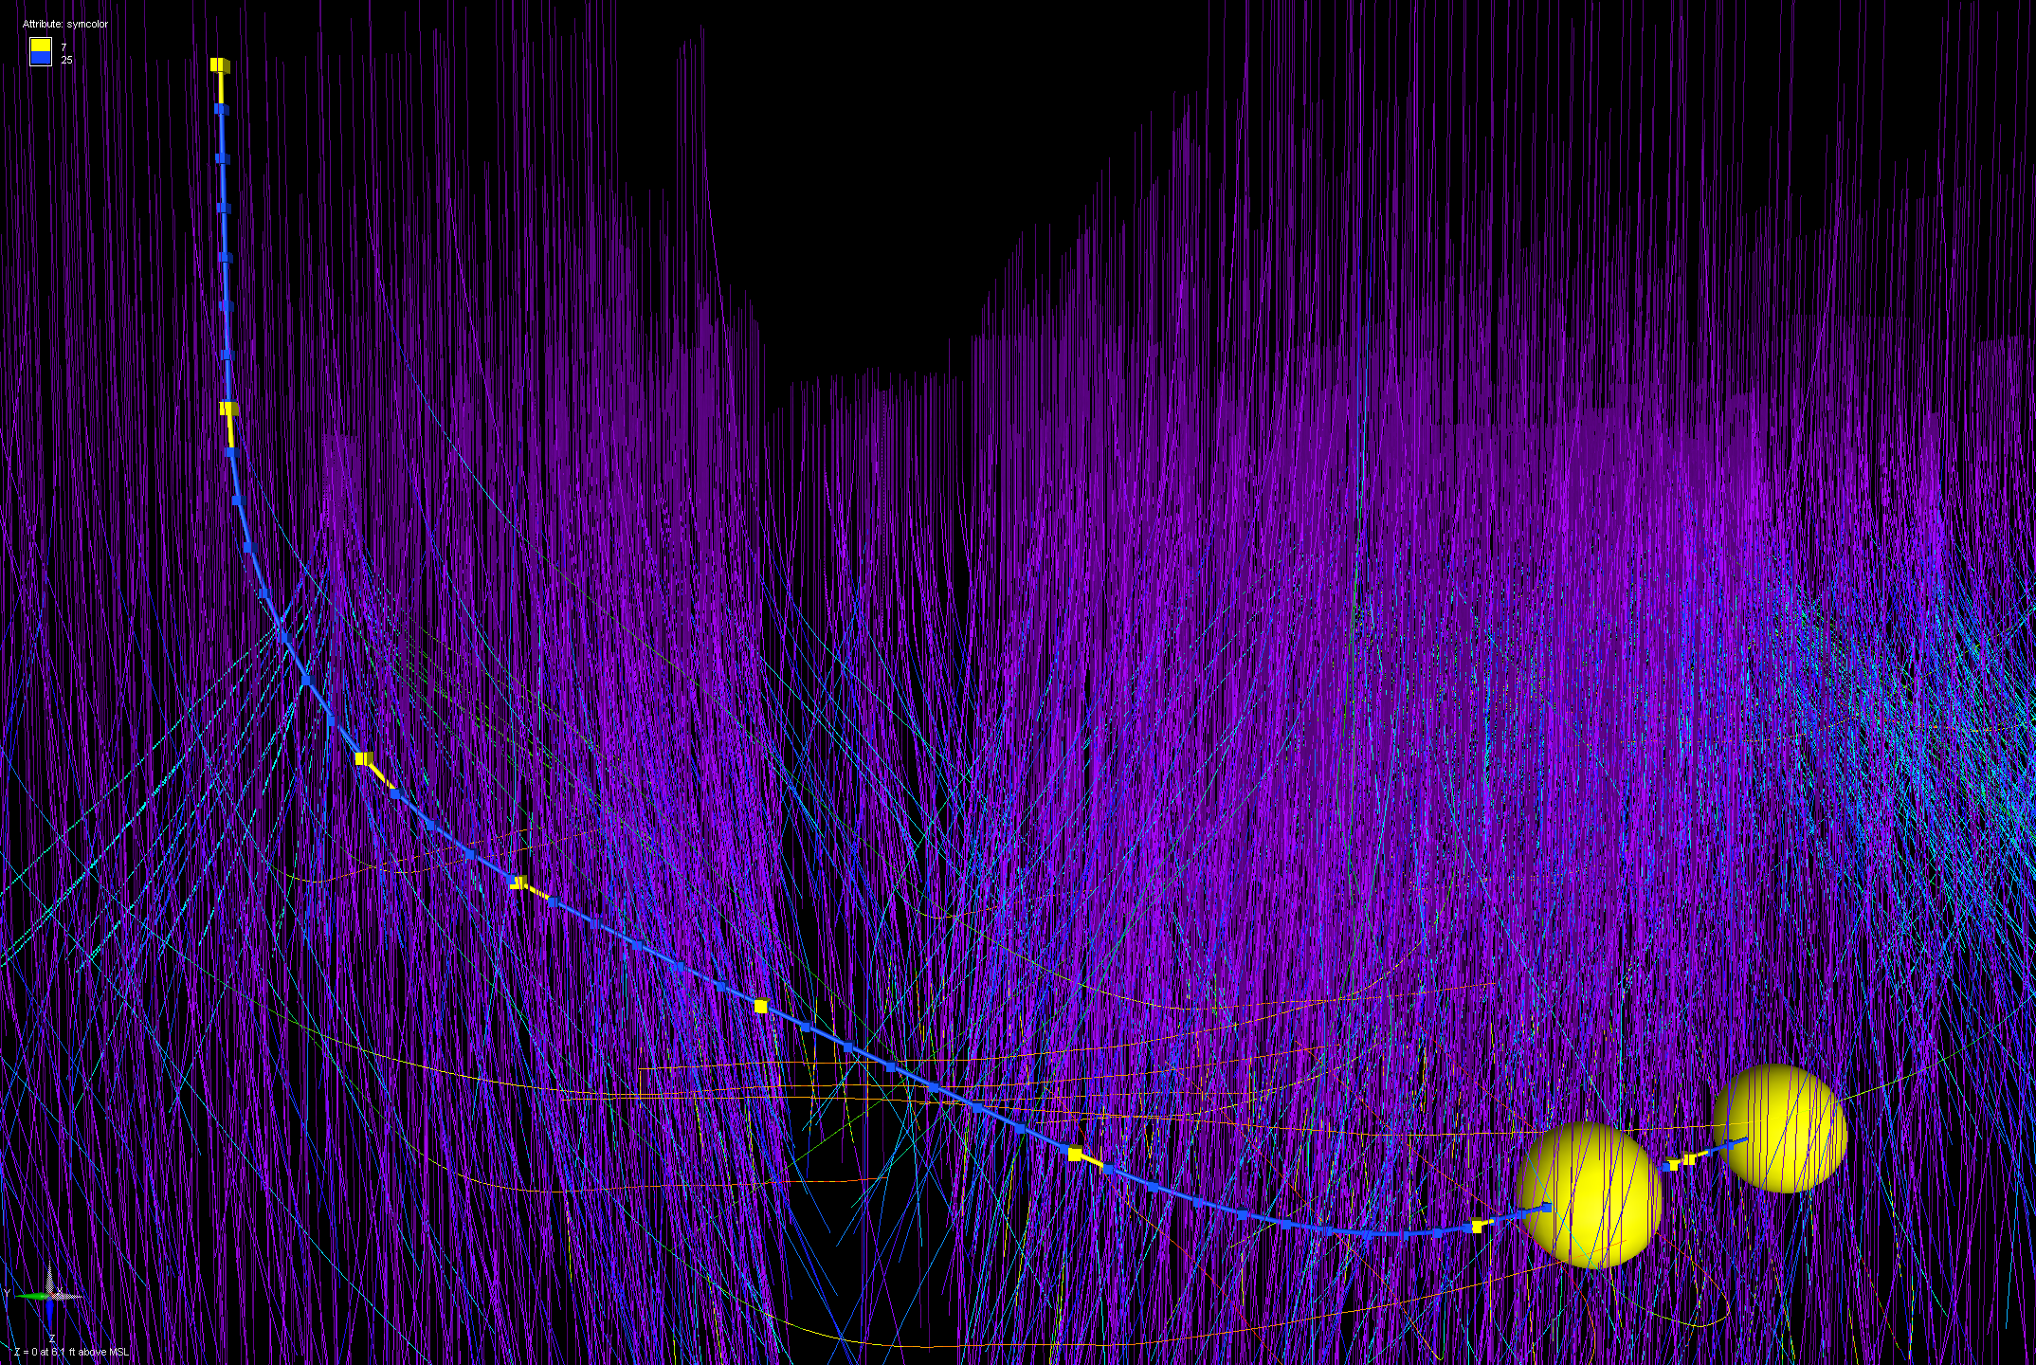
3D Horizontal Wellpath with Offsets

Slide 26
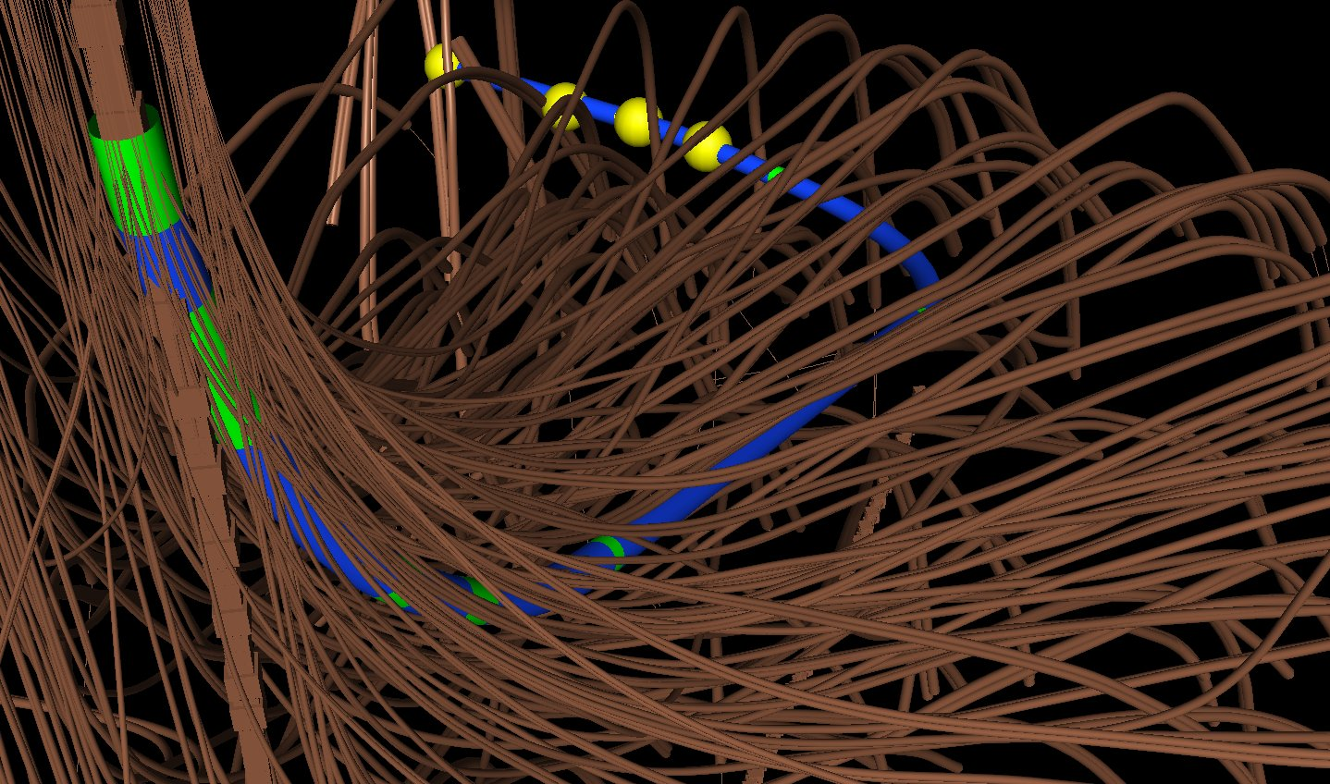
Horizontal Wellpath with Large Azimuth Turn

Slide 27
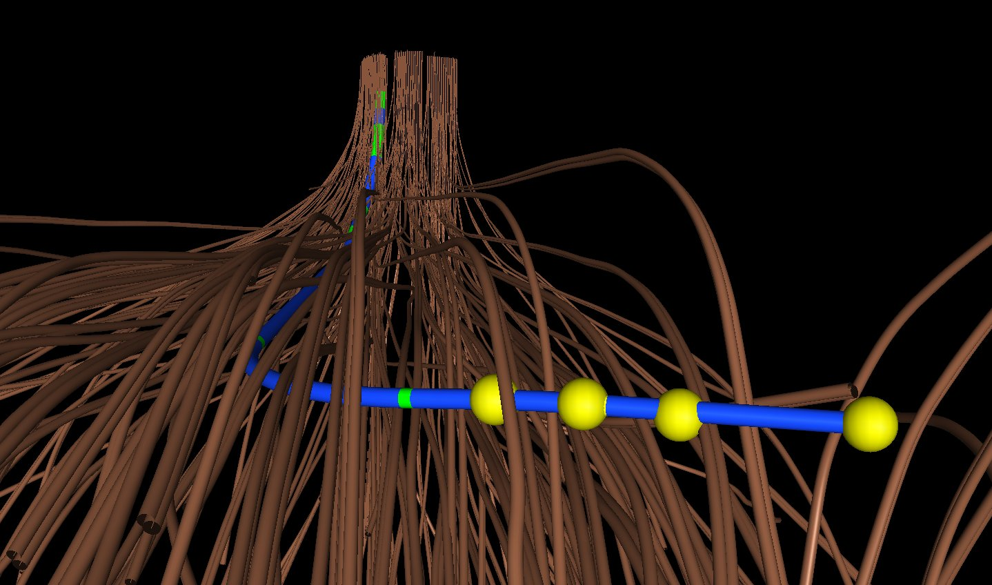
Alternate View Horizontal Wellpath

Slide 28
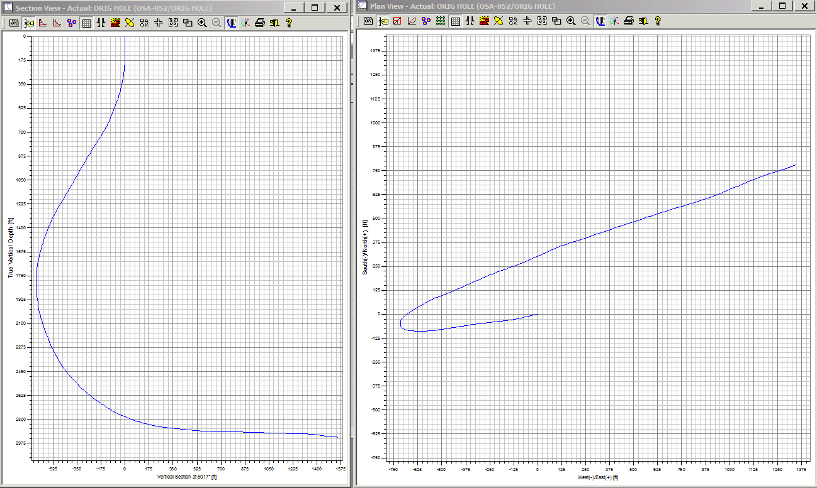
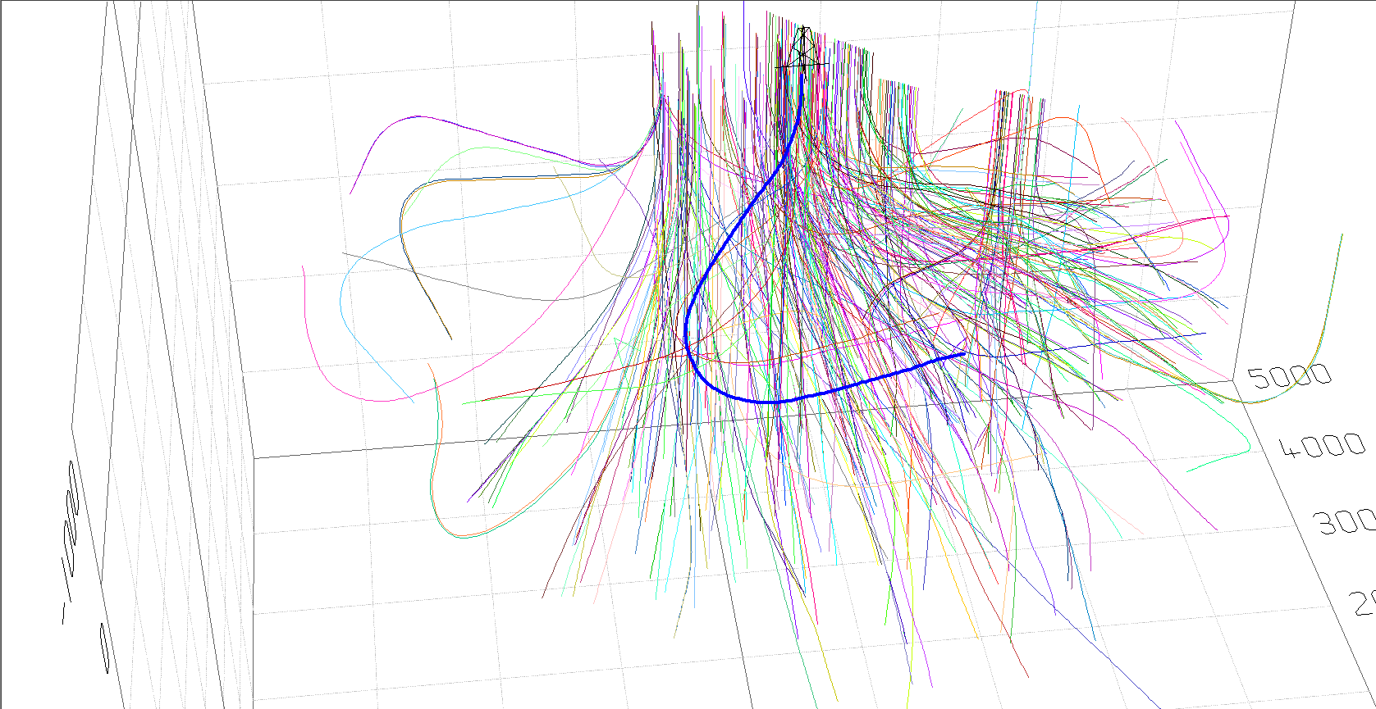
Tidelands Horizontal

Slide 29


